Slide 1
Gesture-Controlled Presentation System
Ashutosh Sharma
Bca-6-c

Slide 2
Introduction
In today's digitally-driven world, presentations serve as a vital medium for
sharing information, ideas, and concepts across a wide spectrum of fields. But
the traditional methods of navigating through presentation slides using
remotes or keyboards can feel clunky, disconnected and passive. It often
hinders the natural flow of communication and disrupts the presenter's
connection with the audience due to their limitations in interactivity. The
Gesture-Controlled Presentation System aims to tackle this problem by
developing a gesture-controlled system that enables presenters to seamlessly
control slide navigation and content interaction through intuitive hand
gestures.

Slide 3
Tools Used
Integrated Webcam
Machine Learning Libraries (e.g., OpenCV)
Presentation Software APIs (e.g., PowerPoint API)
Programming Languages (e.g., Python)

Slide 4
Constraints
The accuracy of gesture recognition depends on lighting conditions and hand positioning.
The system's performance is influenced by the processing power of the host computer.

Slide 5
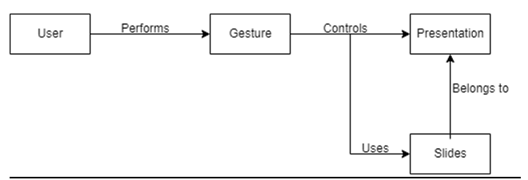
ER Diagram
An ER Diagram to depict the relationships between Users, Gestures, Presentations, and Slides.

Slide 6
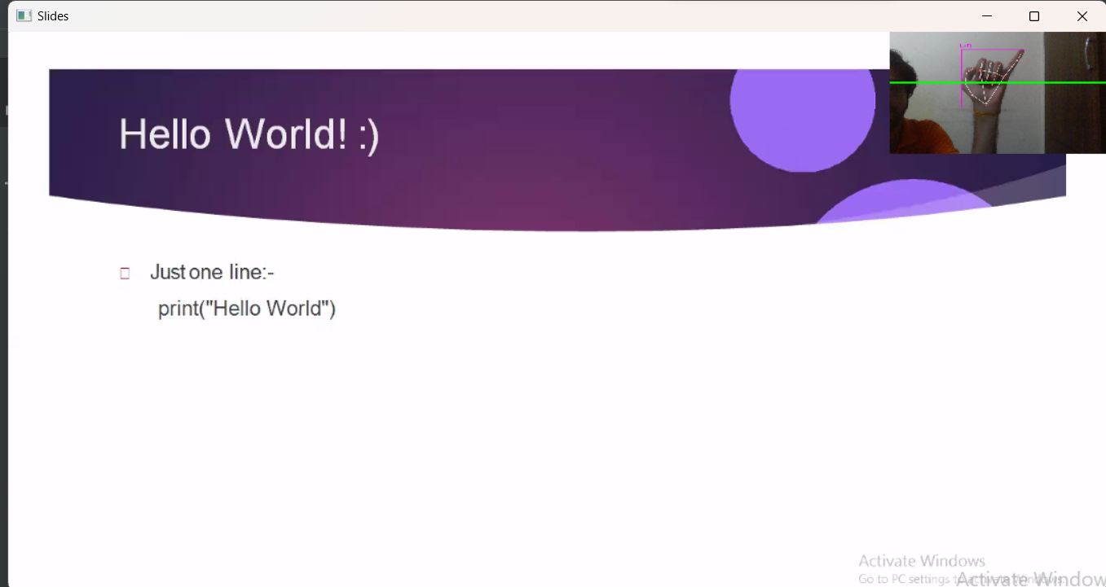
Screen Shots
Next Page

Slide 7
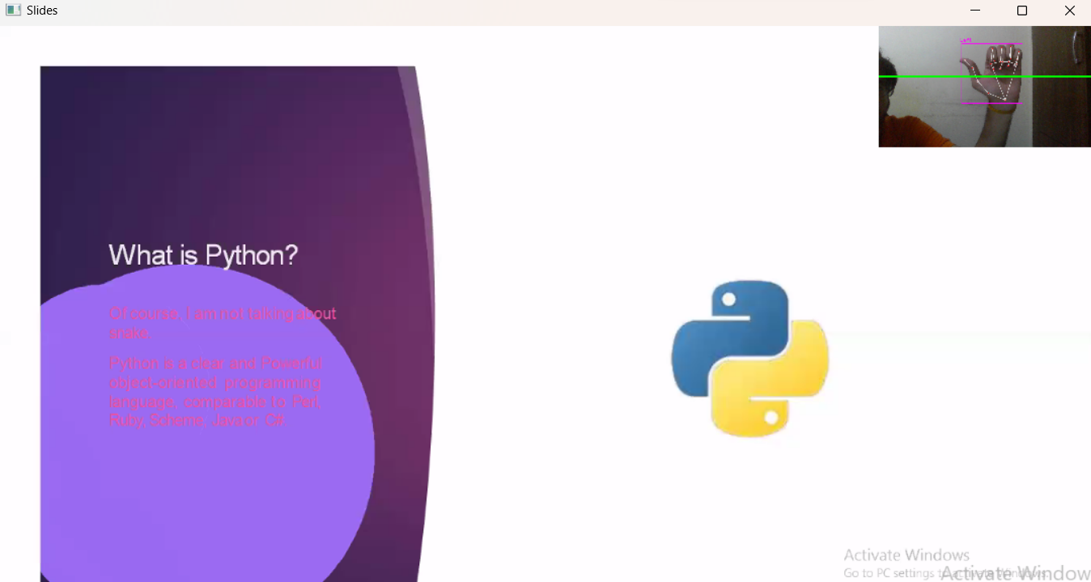
Screen Shots
Previous Page

Slide 8
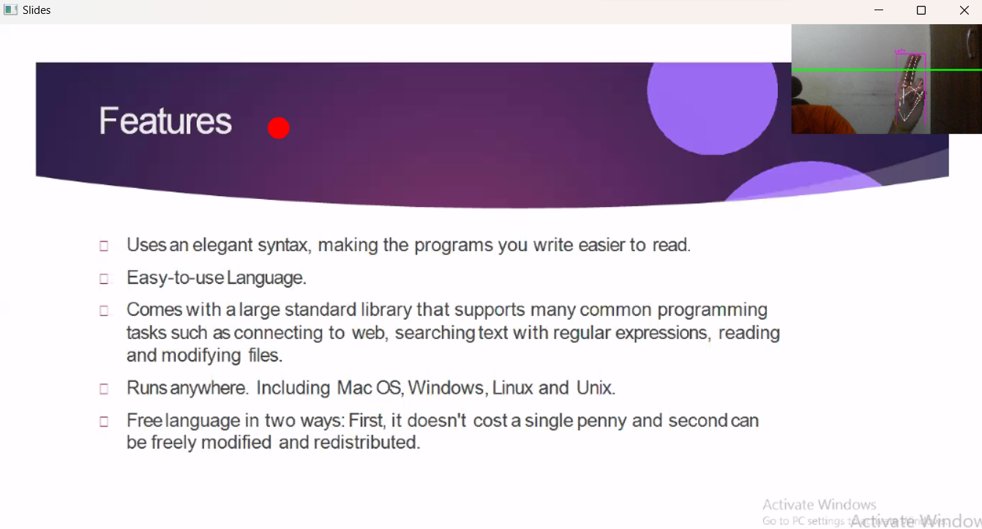
Screen Shots
Pointer

Slide 9
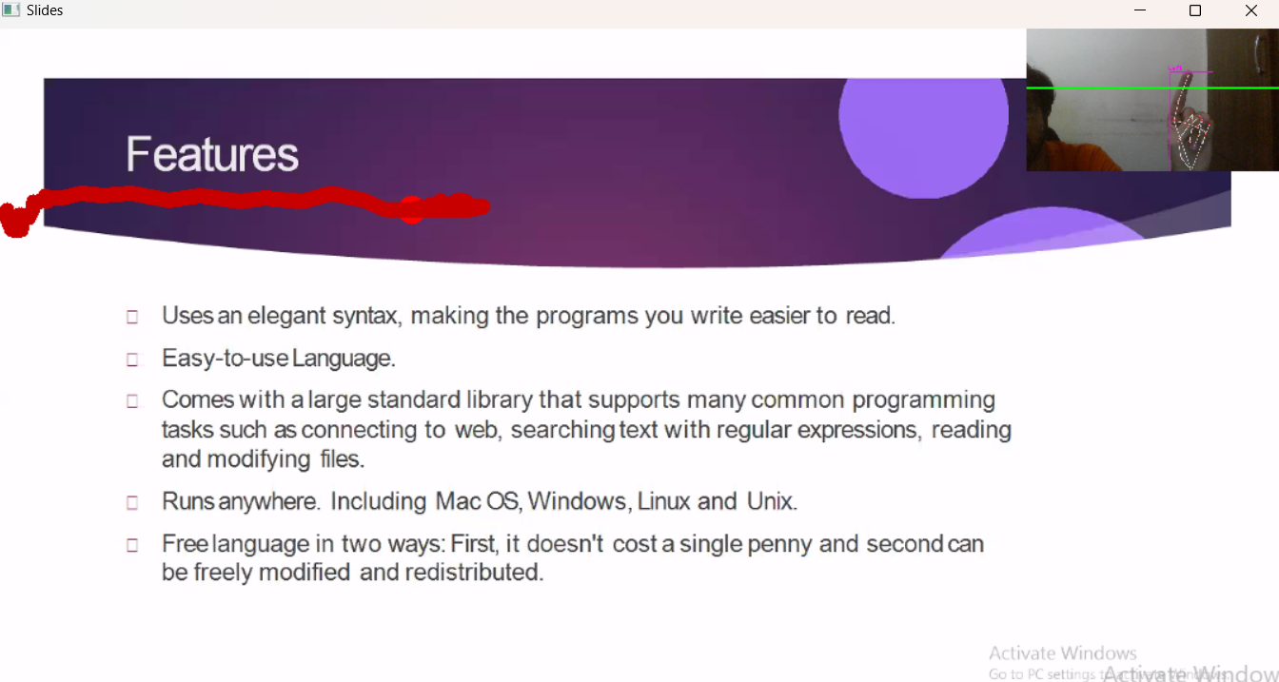
Screen Shots
Draw

Slide 10
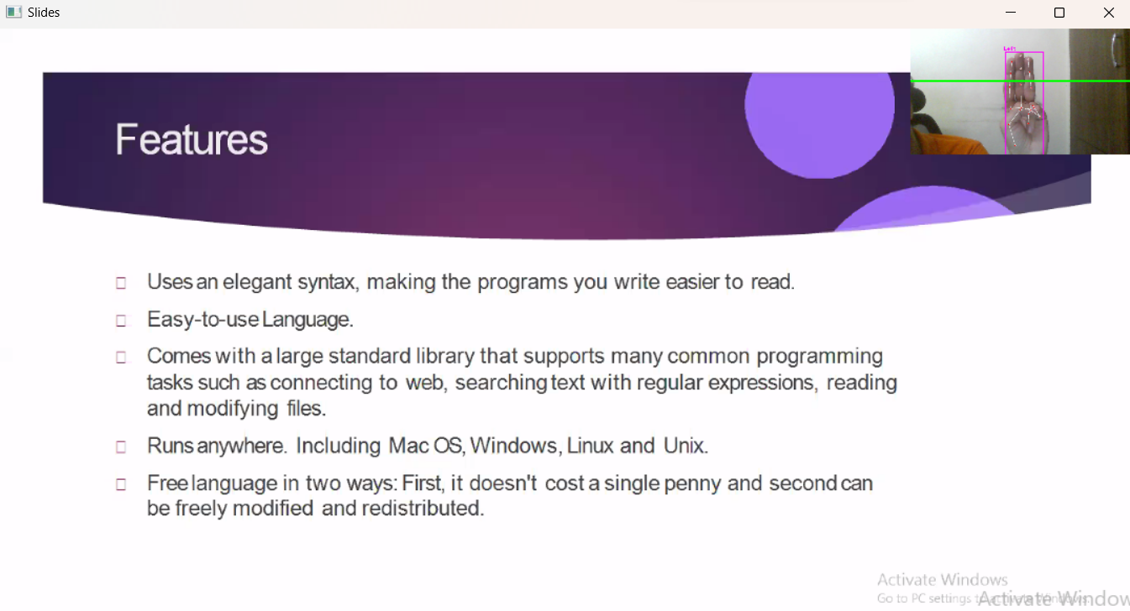
Screen Shots
Erase last drawn figure

Slide 11
Future Scope of the Project
Advanced Gesture Vocabulary
There is a possibility of extending the gesture vocabulary to include more complex and context-specific gestures, enhancing the system's capabilities and interaction possibilities.
Integration with Virtual Reality
We can explore the ways in which we can integrate the Gesture-Controlled Presentation System with virtual reality environments, creating immersive presentation experiences that go beyond traditional slide decks.
Collaborative Gesture-Controlled Environments
We can also envision a future where multiple presenters can interact with the same presentation simultaneously, allowing for collaborative gesture-based interactions in real-time.
Integration into PowerPoint
We can calibrate the software to integrate and run with presentation software like Microsoft PowerPoint.

